Slide 1










ATS
IT
CSS
web
Presented by Tú And Vỹ
html
Ads

Slide 2






TABLE OF CONTENTS
INTRODUCE
CSS SYNTAX
CSS PROPERTIES
CSS POSITION
CSS FLEXBOX

Slide 3




INTRODUCTION
CSS describes how HTML elements are to be displayed on screen, paper, or in other media
CSS saves a lot of work. It can control the layout of multiple web pages all at once
External stylesheets are stored in CSS files

Slide 4
CSS HOW TO
EXTERNAL CSS
INTERNAL CSS
INLINE CSS
External styles are defined within the <link> element, inside the <head> section of an HTML page:
Internal styles are defined within the <style> element, inside the <head> section of an HTML page:
Inline styles are defined within the "style" attribute of the relevant element
THREE WAYS

Slide 5

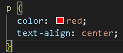

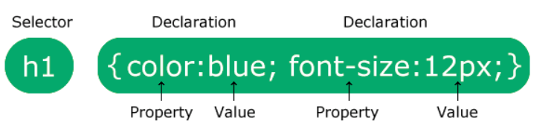


CSS SYNTAX

Slide 6
CSS PROPERTIES
DISPLAY PROPERTIES
BOX MODEL
TEXT PROPERTIES
BACKGROUND PROPERTIES
POSITIONING PROPERTIES
OTHER PROPERTIES

Slide 7
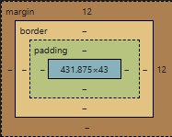
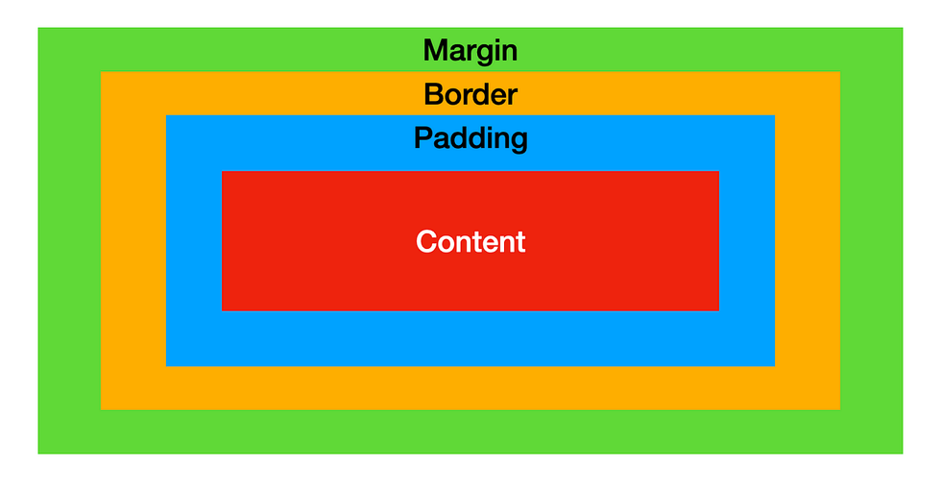
BOX MODEL

Slide 8
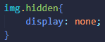
DISPLAY PROPERTIES
Some display properties:
Block
Hidden
Inline

Slide 9
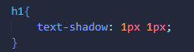
TEXT PROPERTIES
Many text properties:
Text color
Text allignment
Text Decoration
Text Transformation
Text spacing
Text Shadow

Slide 10
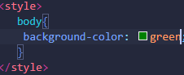
BACKGROUND PROPERTIES
Some background properties:
background color
background image
....
Ref: CSS Backgrounds (w3schools.com)

Slide 11
static
POSITION ELEMENTS
There are five different position values:
absolute
relative
Fixed
...
Ref: CSS Backgrounds (w3schools.com)

Slide 12
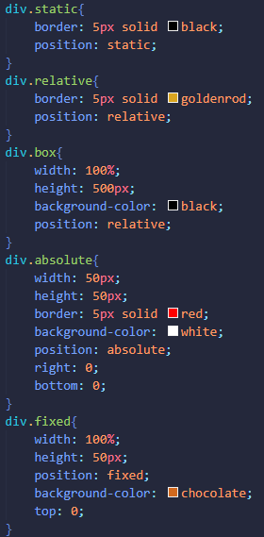
POSITIONING PROPERTIES
Some positioning properties:
top
bottom
left
right
...

Slide 13
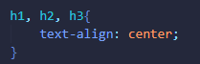
OTHER COMMON
PROPERTIES
Some positioning properties:
width
height
...

Slide 14
PSEUDO CLASSES AND
ELEMENTS
PSEUDO ELEMENTS
PSEUDO CLASSES

Slide 15
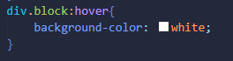
PSEUDO CLASSES
Some pseudo classes:
:hover
:first-child
...
Ref: CSS Pseudo-classes (w3schools.com)

Slide 16
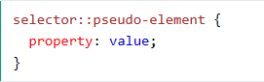
PSEUDO ELEMENTS
Some pseudo elements:
::first-line
::first-letter
::before
::after
::marker
::selection

Slide 17
HTML FLEXBOX
FLEX CONTAINER
FLEX ITEMS

Slide 18
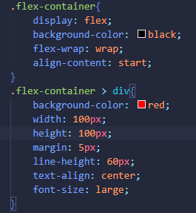
FLEX CONTAINER
Properties of flex container:
flex-direction
flex-wrap
flex-flow
justify-content
align-items
align-content

Slide 19
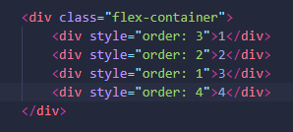
FLEX ITEMS
Properties of flex items:
Orders
Flex-grow
Flex-shrink
Flext-basis
Align-self

Slide 20

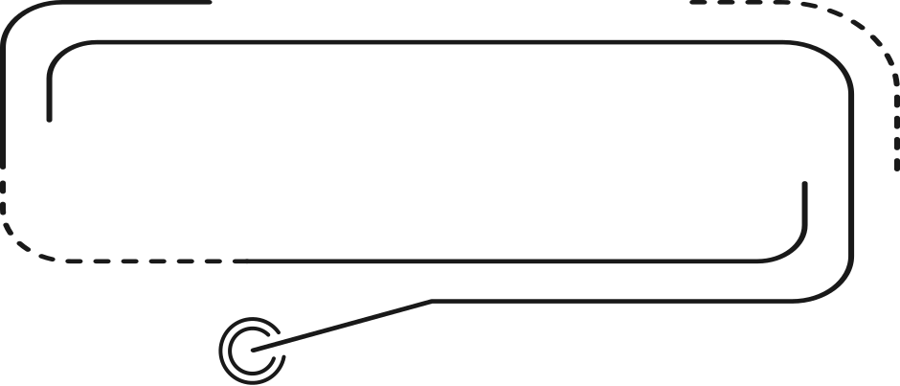
CSS BASIC
THANK YOU
THANKS EVERYONE FOR JOINING THIS SEMINAR

